Slide 1





DU CODING BOOTCAMP 13 – ETL* TEAM PROJECT: indeed_scrap_frame
OMER FARUK KURBAN, PHD, MSC, BSISE
SELCUK ATTILA TURKOZ, MBA, BSME
- - - - - - - - - - - - - - - - - - - - - - - - - - - - - - - -
*EXTRACT-TRANSFORM-LOAD

Slide 2

PART I: EXTRACT DATA - VIA WEB SCRAPING
Requests:
Pull entire html source code of the web page by the help of requests module
BeautifulSoup
Parse html obtained via requests module
Firstly create an iterable object by FIND_ALL() function

Slide 3



PART iI: transform DATA -parse>list>dataframe
BeautifulSoup
Define a function to loop through each item:
Job title, location, company, description, url
PANDAS
Create a dataframe by dictionary of lists
Lists are to be obtained through functions

Slide 4

PART IiI: load results -DATAFRAME>HTML -HTML>WEB-FRAME
PANDAS
TRANSFORM DATA TO HTML TO PUBLISH ON WEB
FLASK
MICRO WEB FRAMEWORK
USER REQUESTS VIA API
JOB/CITY
SERVER RESPONDS
DATAFRAME-CONVERTED-HTML

Slide 5
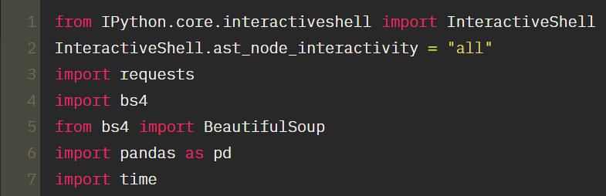
00.dependencies- IMPORTING MODULES
Requests and BeautifulSoup for web scraping
Pandas for data presentation
Multiple output statement

Slide 6
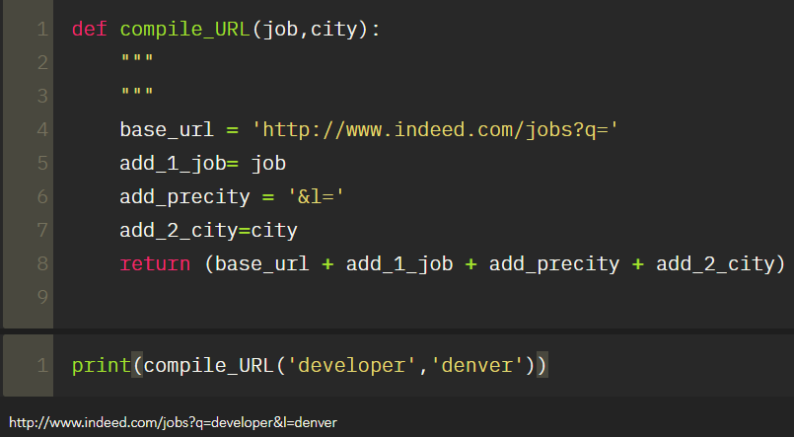

01. DEFINE FUNCTION TO COMpile A query url WITH GIVEN job AND city
Defined function to create a url for making a query with user-defined city and job title
Returns a string value
Crucial function that will be used for numerous times along the code

Slide 7
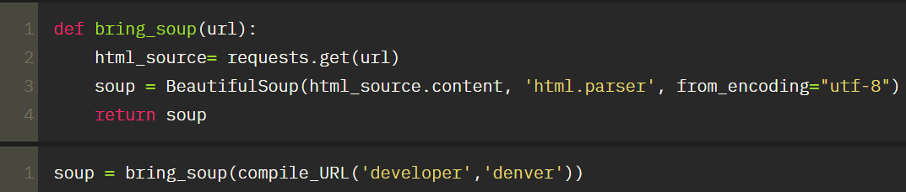
02. DEFINE FUNCTION TO PULL HTML SOURCE CODE
REQUESTS to pull html code
BeautifulSoup to parse html code

Slide 8
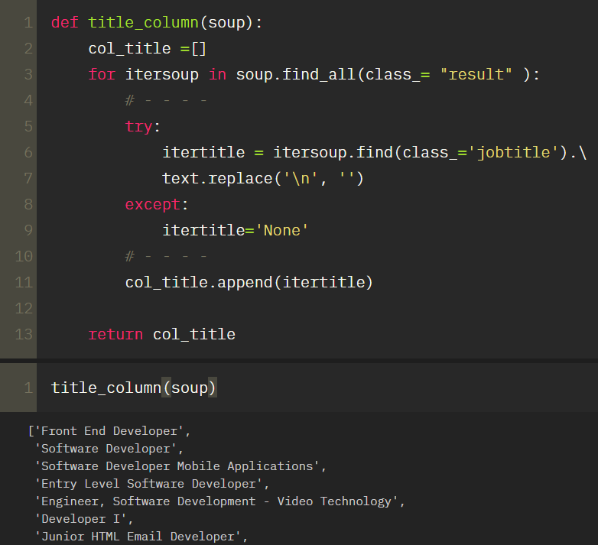
03. Define fuction for job titles
Returns a list consisting of job titles
Column to be used for final output: dataframe

Slide 9
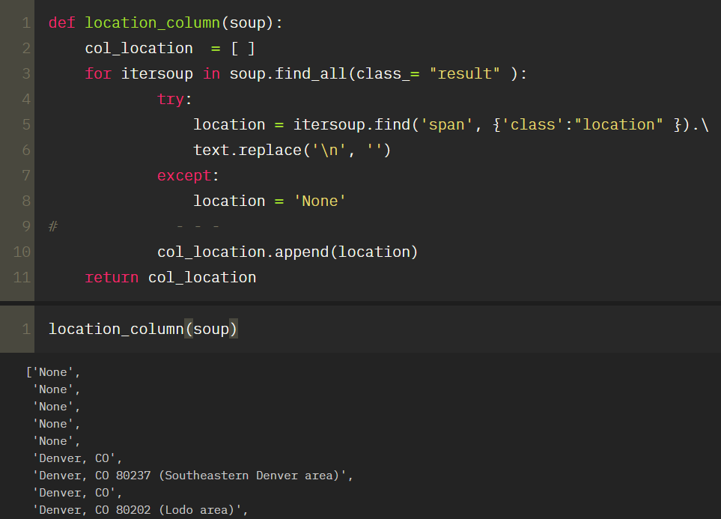
04. Define function for job locations
returns a list with locations if provided on the job ad
If not provided then enters none in order to keep dataframe integrity

Slide 10
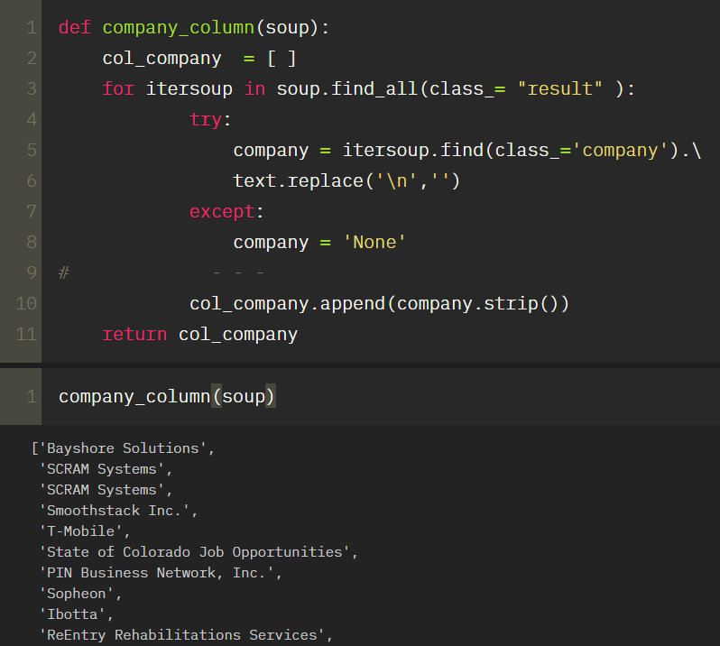
05. Define a function for company name
Returns a list of companies
If company name not provided then enters none

Slide 11
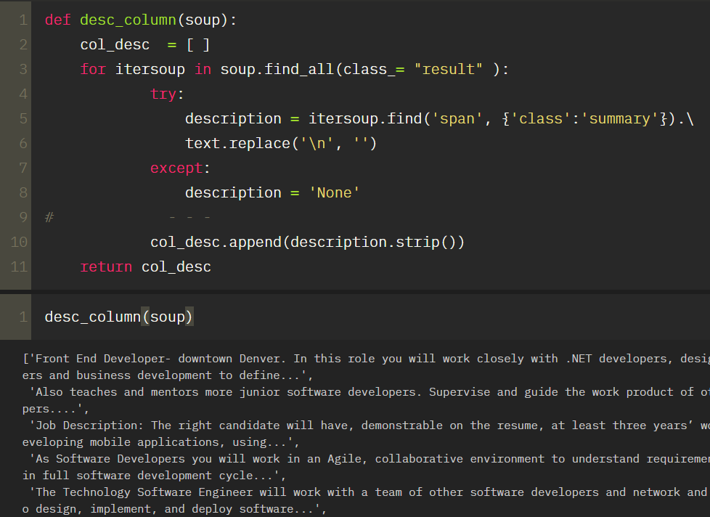
06. Define a function for job description
Returns a list of job descriptions
If description not provided then enters none

Slide 12
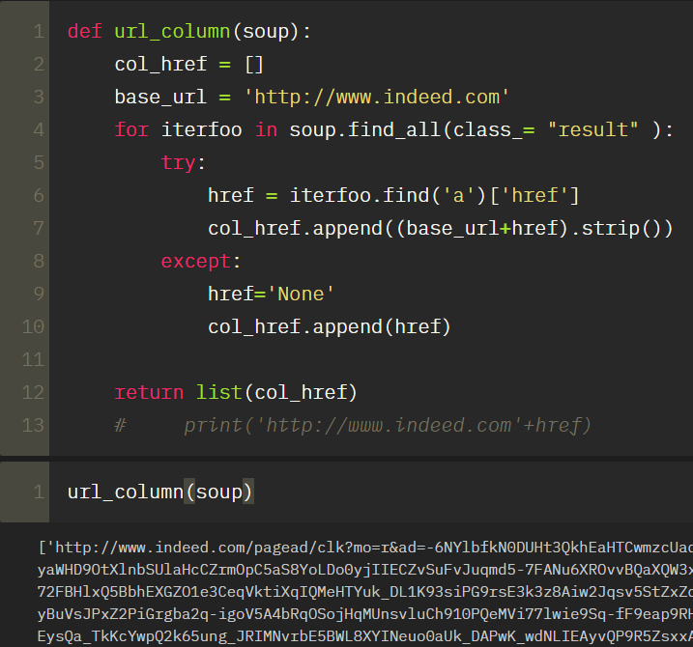
07. Define a function to pull internet link of ads
Pull href: hypertext reference from each ad
Then add this to base url
Return complete url for each job

Slide 13
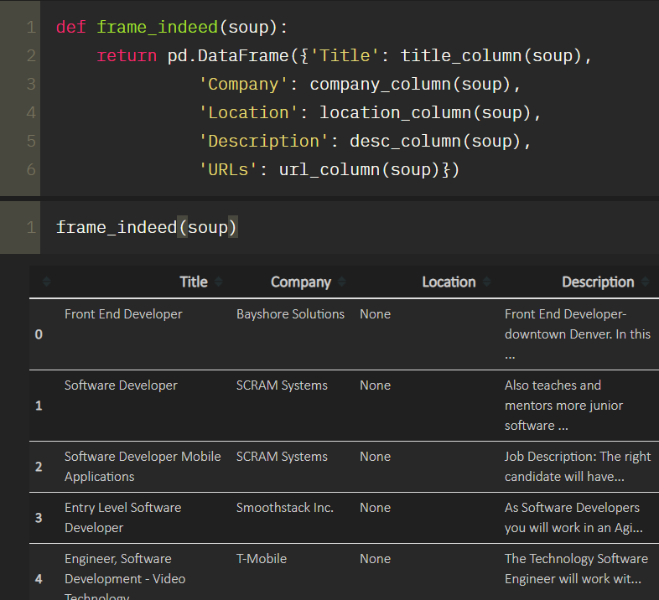
08. Use all functions created previously
Creates a dataframe by dictionaryof lists
Note lists are all returned objects of author-defined functions
url on the right hand side of the table (off-screen)

